Slide 1
615 Final Project
Kailun Huang

Slide 2
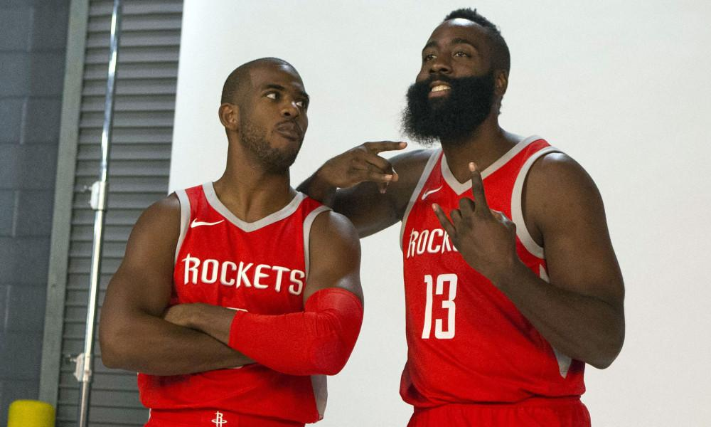
Chris Paul and James Harden
Chris Paul and James Harden are two famous NBA players and they are my idol. This summer Chris Paul left Clippers and joined Rockets. He wanted to play with Harden and win the champion.
I want to know how NBA fan react to this trade and their opinions about their performance on Twitter.

Slide 3
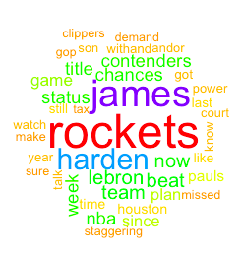
Word Cloud for Chris Paul
The most frequent words with Chris Paul is rockets, james and harden. It is normal because he plays in rockets and his team mates is James Harden.

Slide 4
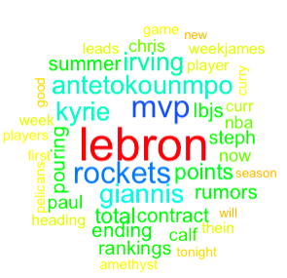
Word Cloud for James Harden
The key words relate to James Harden are “lebron” and “mvp”. These words mean people compliment Harden performance.

Slide 5
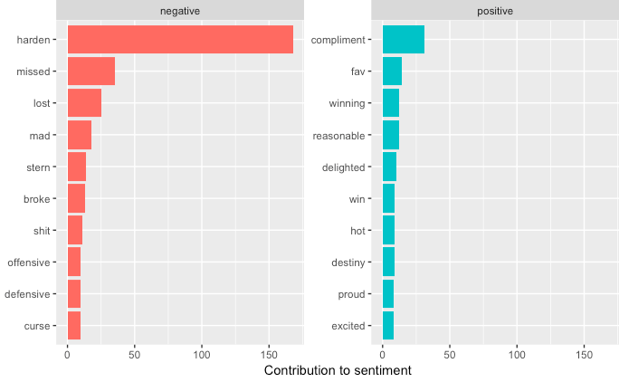
Sentiment Analysis for Chris Paul
The most frequent negative word toward Chris Paul is harden.
The most frequent positive word toward Chris Paul is compliment.

Slide 6
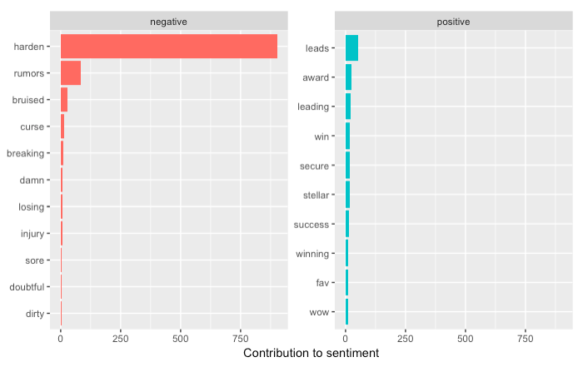
Sentiment Analysis for James Harden
The most frequent negative word toward Harden is harden.
The most frequent positive word toward Harden is lead.

Slide 7
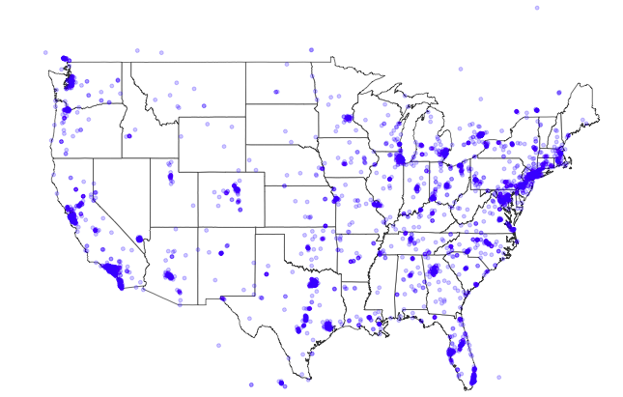
Map of Tweets users comment these two players
Map for Chris Paul

Slide 8
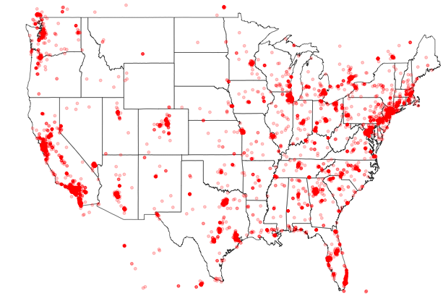
Map for James Harden
We found out that most comments are come from places that have NBA teams.

